Slide 1
Lesson 14: Transfer Functions of Dc Motors
ET 438a Automatic Control Systems Technology

Slide 2
Learning Objectives
After this presentation you will be able to:
Write the transfer function for an armature controlled dc motor.
Write a transfer function for a dc motor that relates input voltage to shaft position.
Represent a mechanical load using a mathematical model.
Explain how negative feedback affects dc motor performance.

Slide 3
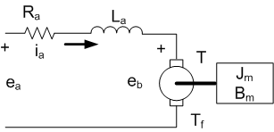
Steady-State Operation of Separately Excited Dc Motors
Consider steady-state model
i_{a} = armature current
e_{b}= back emf
e_{a}= armature terminal voltage
ω_{m} = motor speed (rad/sec)
T = motor torque
T_{f} = static friction torque
R_{a} = armature resistance
L_{a} = armature inductance
J_{m} = rotational inertia
B_{m} = viscous friction
ω_{m}
Review the steady-state relationships
Of machine

Slide 4
Steady-State Operation of Separately Excited Dc Motors
Relationships of Separately Excited Dc Motor
Torque-Current Curve
Back EMF Curve
T
K_{T}=ΔT/Δi_{a}
e_{b}
K_{T}=ΔT/Δi_{a}
ΔT
ΔT
Δi_{a}
Δi_{a}
i_{a}
ω_{m}
-T_{f}
ω_{m}
ω_{m}=ω_{nl} – (Δω_{m}/ΔT)T
Speed-Torque Curve
ω_{nl}
Δω_{m}
ΔT
Τ

Slide 5
Steady-State Motor Equations
Developed Torque
KVL in Armature Circuit
T = motor torque
K_{T} = torque constant
T_{f} = motor friction torque
i_{a} = armature current
e_{a}= armature voltage
e_{b} = back emf
R_{a} = armature resistance
Back EMF
Developed Power
ω_{m}= shaft speed (rad/s)
e_{b} = back emf
K_{e} = back emf constant
P = shaft power

Slide 6
Steady-State Motor Equations
Combining the previous equations gives:
(1)
(2)
If the load torque is zero (T=0) then the above equation (1) gives the no-load speed

Slide 7
Steady-State Motor Operation
Example 14-1: An armature-controlled dc motor has the following ratings: T_{f}=0.012 N-m, R_{a}=1.2 ohms, K_{T}=0.06 N-m/A, K_{e}=0.06 V-s/rad. It has a maximum speed of 500 rad/s with a maximum current of 2 A. Find: a) maximum output torque, b) maximum mechanical output power, c) maximum armature voltage, d) no-load speed at maximum armature voltage.

Slide 8
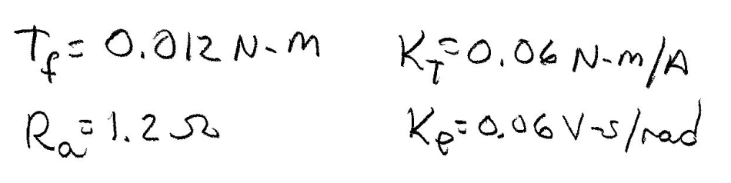
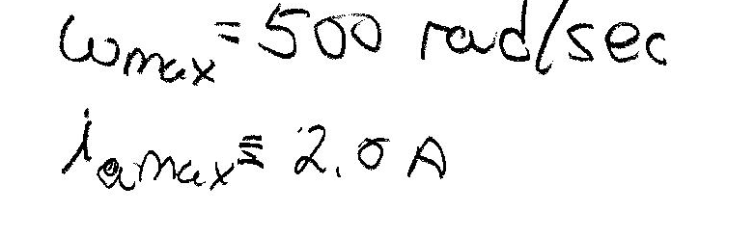
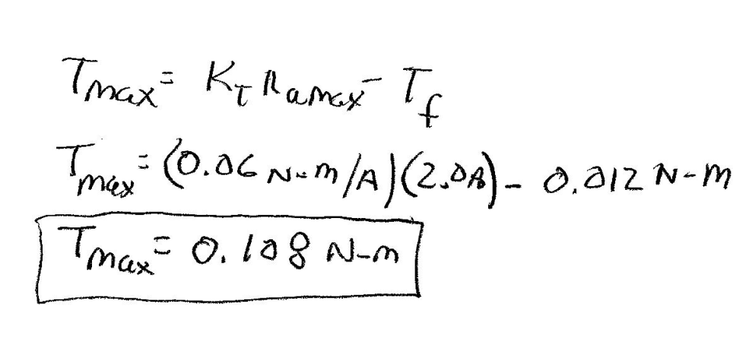
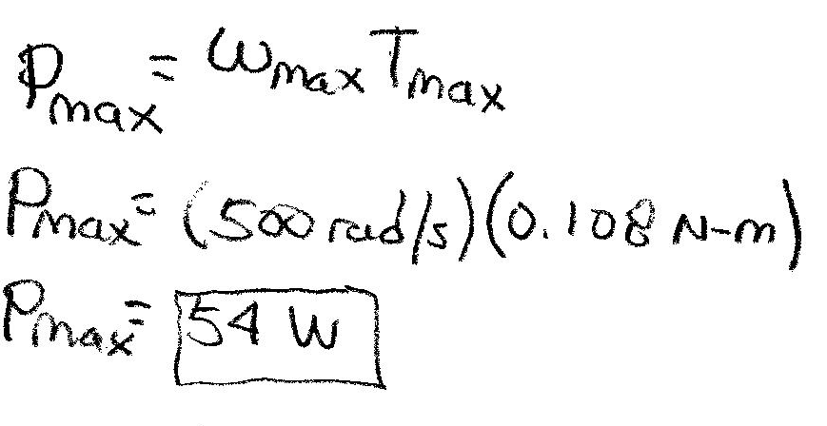
Example 14-1 Solution (1)
Define given variables
a) T_{max} occurs at I_{max} so….
Answer
b) Find P_{max}
Answer

Slide 9
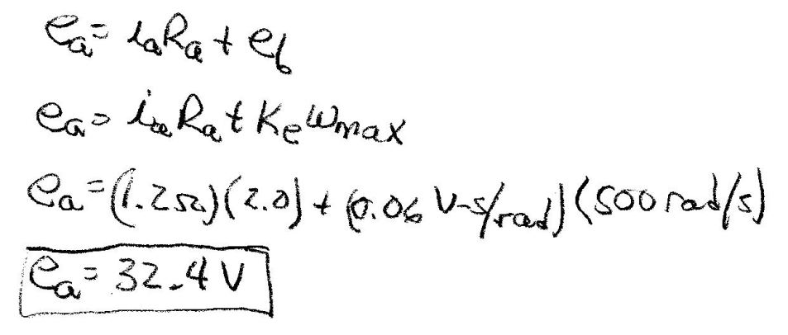
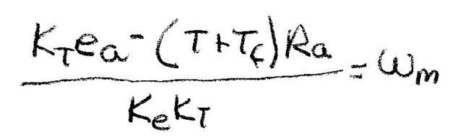
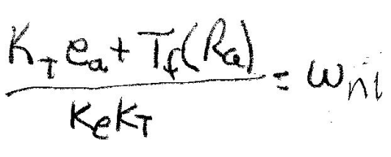
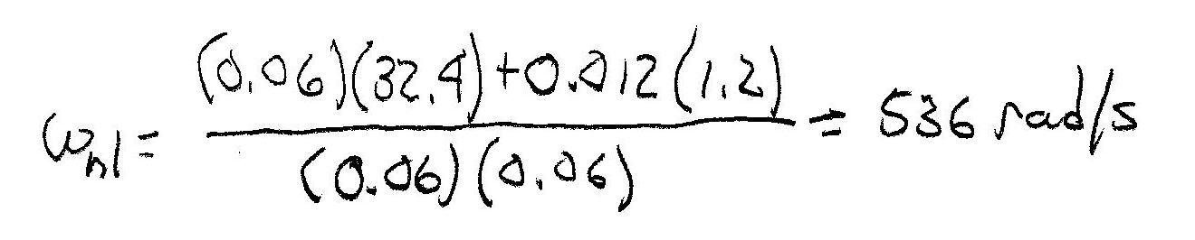
Example 14-1 Solution (2)
c) Find maximum back emf
Answer
d) Find no-load motor speed
At no-load, T=0. Load torque is zero.
T=0

Slide 10
Transfer Function of Armature-Controlled Dc Motor
Write all variables as time functions
Write electrical equations and mechanical equations. Use the electromechanical relationships to couple the two equations.
Consider e_{a}(t) and e_{b}(t) as inputs and ia(t) as output. Write KVL around armature
Mechanical Dynamics

Slide 11
Transfer Function of Armature-Controlled Dc Motor
Electromechanical equations
Find the transfer function between armature voltage and motor speed
Take Laplace transform of equations and write in I/O form

Slide 12
Transfer Function of Armature-Controlled Dc Motor
Laplace Transform of Electromechanical Equations
Laplace Transform of Mechanical System Dynamics
Rewrite mechanical equation as I/O equation

Slide 13
Block Diagram of Armature-Controlled Dc Motor
Draw block diagram from the following equations
T(s)
E_{a}(s)
1/(L_{a}s+R_{a})
I_{a}(s)
K_{T}
1/(J_{m}s+B_{m}⁾
Ω_{m}(s)
+
-
E_{b}(s)
K_{e}
Note: The dc motor has an inherent feedback
from the CEMF. This can improve system stability
by adding a electromechanical damping

Slide 14
Transfer Function of Armature-Controlled Dc Motor
Use the feedback formula to reduce the block diagram
G(s) is the product of all the blocks in the forward path
1/(L_{a}s+R_{a})
K_{T}
1/(J_{m}s+B_{m}⁾

Slide 15
Simplification of Transfer Function
Substitute G(s) and H(s) into the feedback formula
G(s)
H(s)
Simplify by multiplying numerator and
denominator by factors (L_{a}s+R_{a})(J_{m}s+B_{m})
G(s)
Expand factors and collect like terms of s
Final Formula
Roots of denominator effected by values of parameters. Can be Imaginary.

Slide 16
Dc Motor Position Transfer Function
Motor shaft position is the integral of the motor velocity with respect to time. To find shaft position, integrate velocity
To find the motor shaft position with respect to armature voltage, reduce the following block diagram
I_{a}(s)
T(s)
E_{a}(s)
1/(L_{a}s+R_{a})
K_{T}
1/(J_{m}s+B_{m}⁾
Ω_{m}(s)
1/s
Θ_{m}(s)
+
-
E_{b}(s)
K_{e}

Slide 17
Dc Motor Position Transfer Function
Position found by multiplying speed by 1/s (integration in time)
T.F.

Slide 18
Reduced Order Model
Define motor time constants
Where: τ_{m} = mechanical time constant
τ_{e} = electrical time constant
Electrical time constant is much smaller than mechanical time constant. Usually neglected. Reduced transfer function becomes…

Slide 19
Motor with Load
Consider a motor with load connected through a speed reducer.
Load inertia = J_{L}
Load viscous friction = B_{L}
Motor coupled to speed reducer, motor shaft coupled to smaller gear with N₁ teeth. Load connected to larger gear with N₂ teeth.
Gear reduction decreases speed but increases torque P_{mech}=constant. Similar to transformer action

Slide 20
Motor with Load
Speed changer affects on load friction and rotational inertia
Without speed changer (direct coupling)
With speed changer
Where: B_{T} = total viscous friction
J_{T} = total rotational inertia
B_{L} = load viscous friction
B_{m} = motor viscous friction
J_{m} = motor rotational inertia
J^{L} = load rotational inertia

Slide 21
Motor with Load Block Diagram
I_{a}(s)
T(s)
E_{a}(s)
1/(L_{a}s+R_{a})
K_{T}
1/(J_{T}s+B_{T}⁾
Ω_{m}(s)
N₁/N₂
Ω_{L}(s)
+
-
E_{b}(s)
K_{e}
Inertia and friction of load included
Transfer function with speed changer

Slide 22
Motor Position with Load Block Diagram
I_{a}(s)
T(s)
Ω_{m}(s)
E_{a}(s)
1/(L_{a}s+R_{a})
K_{T}
1/(J_{T}s+B_{T}⁾
N₁/N₂
1/s
Θ_{L}(s)
+
-
E_{b}(s)
Ω_{L}(s)
K_{e}
Motor position transfer function with speed changer. Note: multiplication by s

Slide 23
Dc Motor Transfer Function Example
Example 14-2: A permanent magnet dc motor has the following specifications.
Maximum speed = 500 rad/sec
Maximum armature current = 2.0 A
Voltage constant (K_{e}) = 0.06 V-s/rad
Torque constant (K_{T}) = 0.06 N-m/A
Friction torque = 0.012 N-m
Armature resistance = 1.2 ohms
Armature inductance = 0.020 H
Armature inertia = 6.2x10⁻⁴ N-m-s²/rad
Armature viscous friction = 1x10⁻⁴ N-m-s/rad
Determine the voltage/velocity and voltage/position transfer functions for this motor
Determine the voltage/velocity and voltage/position transfer functions for the motor neglecting the electrical time constant.

Slide 24
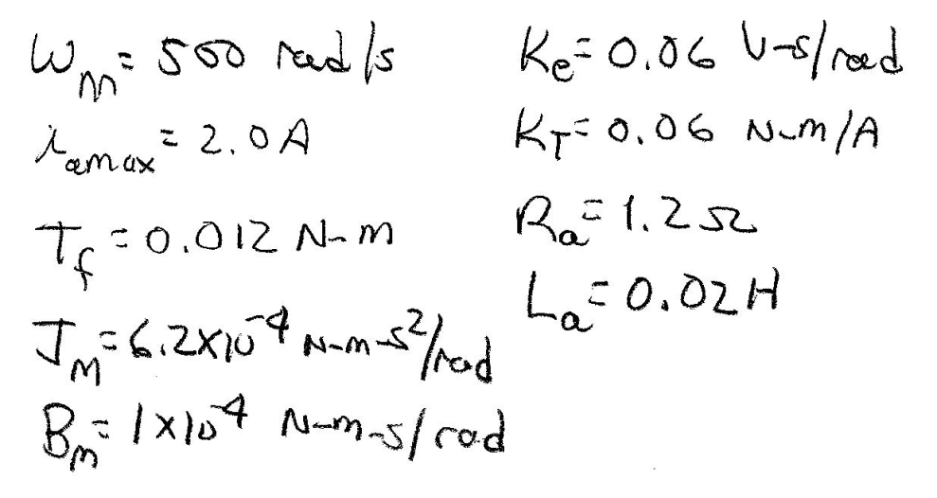
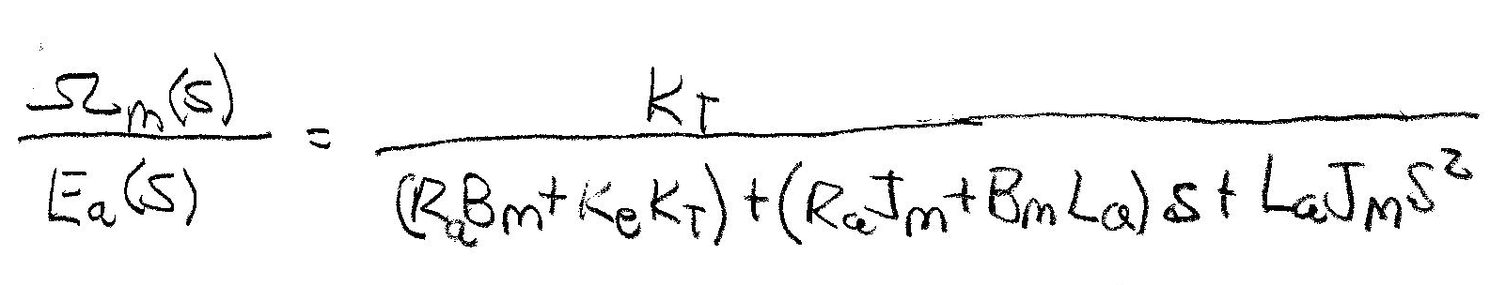
Example 14-2 Solution (1)
Define all motor parameters
a) Full transfer function model

Slide 25
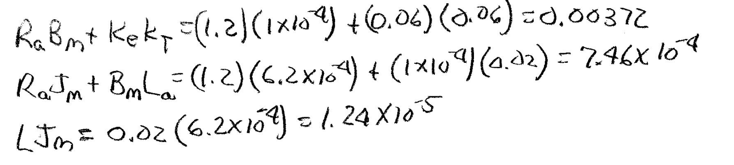
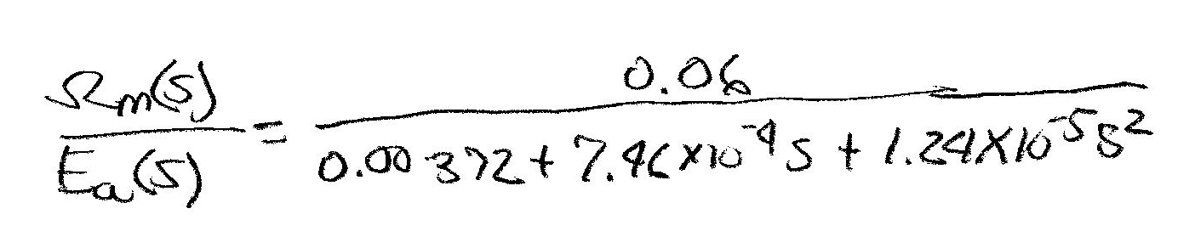
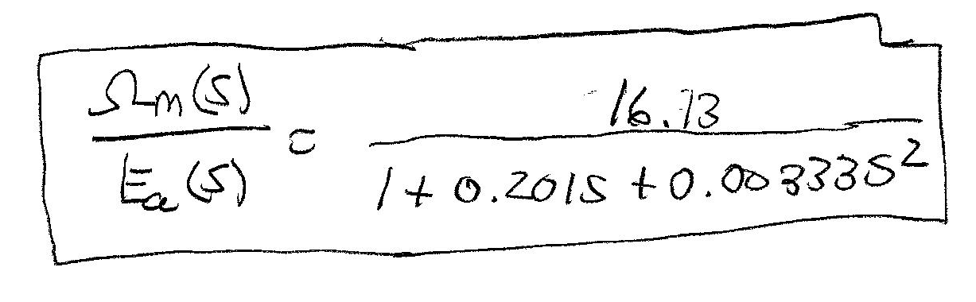
Example 14-2 Solution (2)
Compute denominator coefficients from parameter values
Can normalize constant by dividing numerator and denominator by 0.00372

Slide 26
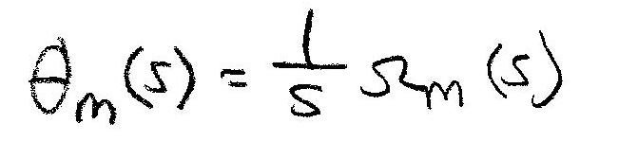
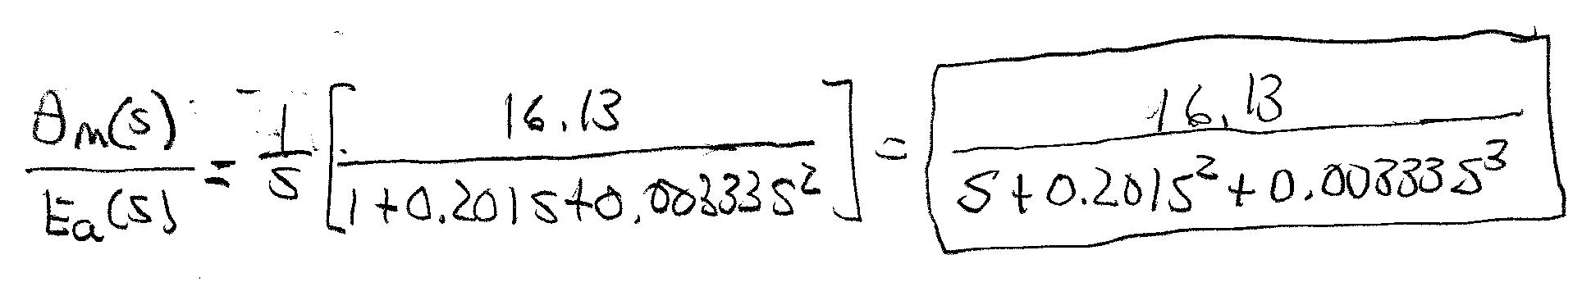
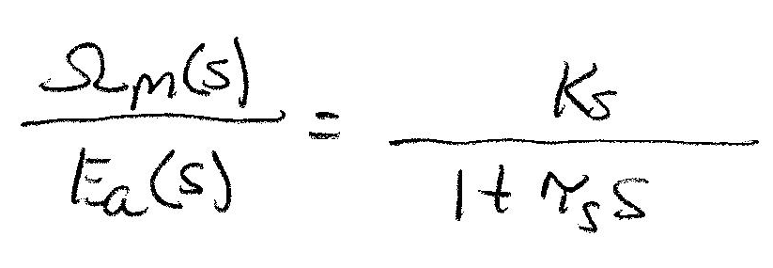
Example 14-2 Solution (3)
To covert this to a position transfer function, multiple it by 1/s
b) Compute the transfer functions ignoring the electrical time constant

Slide 27
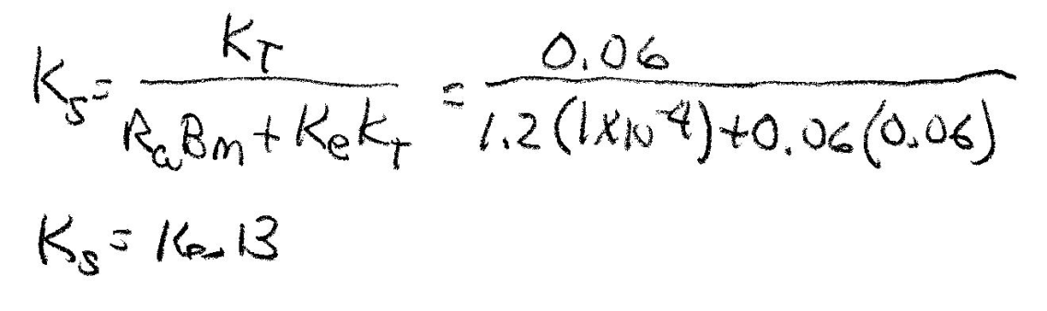
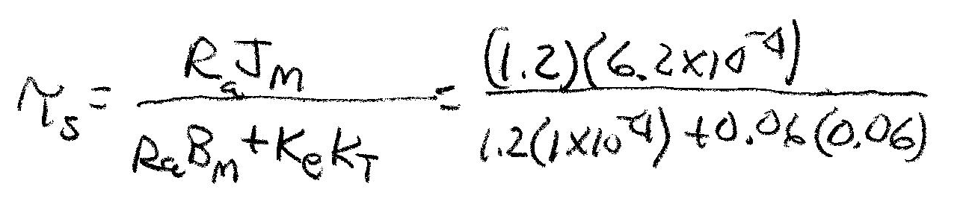
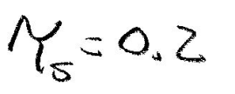
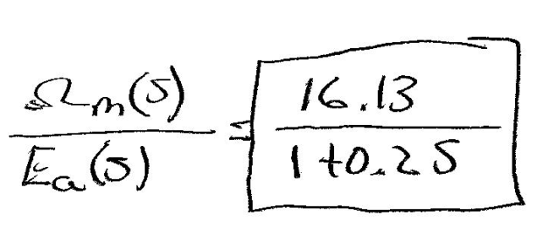
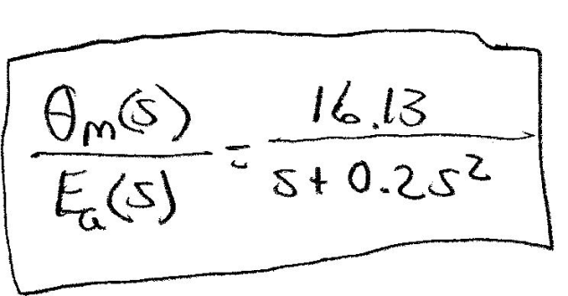
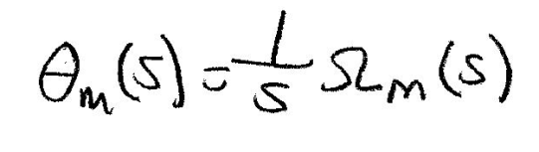
Example 14-2 Solution (4)
Compute parameter values

Slide 28
Lesson 14: Transfer Functions of Dc Motors
ET 438a Automatic Control Systems Technology

